Slide 1
Essentials of telehealth
Notes:
General TeleHealth Tip Sheet
Resources For Conduction TeleHealth Visits
University of Utah TeleHealth LMS Training

Slide 2
TeleHealth: Overview

Slide 3
What is TeleHealth?
Definition: the remote delivery of health care services and clinical information using telecommunications technology. This includes a wide array of clinical services using internet, wireless, satellite, and telephone media¹.
Notes:
Reference: American Telemedicine Association About Telemedicine website. 2018. Retrieved from http:// www.americantelemed.org/main/about/about-telemedicine/telemedicine-faqs¹.

Slide 4
Various Uses of TeleHealth
Interdisciplinary Care Augmentation
Hospital to Hospital Educational Conferences and Quality Improvement Initiatives
Direct Clinical Practice
Non-Emergent Outpatient Provider to Patient Visits
Available across a variety of healthcare specialties and disciplines
Emergent Provider to Patient Visits
Tele-Stroke, Tele-Psych, Tele-Burn, Tele-ICU
Notes:
Reference: American Telemedicine Association About Telemedicine website. 2018. Retrieved from http:// www.americantelemed.org/main/about/about-telemedicine/telemedicine-faqs.

Slide 5
Wide Range Of Specialties That Use TeleHealth
Internal Medicine
Family Medicine
Neurology
Psychiatry/ Psychology
Dermatology
Emergency Medicine
ICU
Pediatrics
Radiology
Physical Medicine & Rehab
Burn
Notes:
Reference: American Telemedicine Association About Telemedicine website. 2018. Retrieved from http:// www.americantelemed.org/main/about/about-telemedicine/telemedicine-faqs.

Slide 6
Various TeleHealth Platforms
Notes:
Reference: American Telemedicine Association About Telemedicine website. 2018. Retrieved from http:// www.americantelemed.org/main/about/about-telemedicine/telemedicine-faqs.

Slide 7
TeleHealth and COVID -19
University Approved Platforms:
MyChart via Epic (preferred platform)
InTouch, Zoom via the University of Utah server, Web Ex, Vidyo, Account Access:
You will need to discuss with your faculty supervisor prior to the start of your rotation to understand what platform they are using to conduct their televisits.
If faculty would like you to participate in a visit, you will likely be using their account links to initiate visits, but confirm how they want to do this

Slide 8
TeleHealth: Limitations & Benefits

Slide 9
benefits
Increases cost efficiency
Reduces transportation expenses
Improves patient access to specialists and mental health providers especially in rural and underserved areas
Allows for social distancing
Can reduce delays in care

Slide 10
Limitations
Patients may have difficulty obtaining their vitals
Reduced ability to complete a physical exam, which can impact diagnostic accuracy and work-up decisions
Perceived as less “personal”
Can result in more steps to provide multidisciplinary care than in-person visits
Technical difficulties can occur

Slide 11
Preparing: Getting Your TeleHealth Visit Set Up

Slide 12
Consent and Verification
Patients must consent to care via telehealth prior to the start of the visit
This is usually conducted during scheduling
Clinicians/students should take reasonable and appropriate steps to verify the identity of the patients, and properly represent their own identity and credentials to patients.
Notes must provide documentation of consent, location of patient, location of teleprovider, appointment start time and appointment stop time
Notes:
COVID-19 Verbal Consent Tip Sheet
Getting Verbal Consent for Virtual Visits
Interpreter Services
How to Access Patient Consent Forms

Slide 13
Provider Set-Up
Background: Ensure there is minimal complexity and little movement to preserve video quality
No fans, better against a plain wall than a large room
Lighting: Needs to be brightly lit in front, but avoid backlighting
Sound: A headset is ideal to prevent feedback
If you get feedback, turn down the speaker volume (do NOT move microphone farther away, this will worsen the quality)
Notes:
Selecting a Professional Virtual Background
TeleHealth Backgrounds for Zoom

Slide 14
patient Set-Up
Patient & Guests: Ask to minimize # of people to 1-2, minimize movement, ideal to rest device on surface rather than having them hold it.
Patient Environment: Quiet well-lit room away from pets, children. May encourage participants to speak one at a time.
Physical Assistance: Could ask scheduler to coordinate with home health availability (if possible).
Notes:
Patient TeleHealth Visit Checklist

Slide 15
TelePresence: Conducting Your Virtual Visit

Slide 16
TelePresence
Note delta angle between camera and patient image on screen
You’ll need to counterintuitively look at camera (not your screen) when speaking to maintain eye contact, otherwise explain to patient why you may not be making eye contact.
When multitasking, need to be explicit to patient what you are doing and that you are still paying attention
Start encounter by getting/writing all names of those present for the visit; you will need to use names (instead of body language) to direct your questions
Ask those speaking to come into view of camera (both to direct your attention and due to directional microphone)

Slide 17
TelePresence
Developing patient rapport can be more difficult over the camera due to a “virtual barrier.” Be conscientious of this.
Many technical difficulties can arise, so maintain professionalism if the patient is struggling with setting-up the visit.
Have access to support/help line number to assist patient in resolving these difficulties

Slide 18
TelePresence and Professionalism
Notes:
Reference: American Academy of Allergy Asthma & Immunology. (2020, April 23). How to Conduct a Professional Telemedicine Visit Using Good Webside Manner [Video]. YouTube. https://www.youtube.com/watch?v=8bMFL56Zflc&t=220s

Slide 19
TelePresence Dos & Don’ts
Notes:
Reference: Portico Network. (2017, June 2). Telemental Health Tips: Don'ts and Do's [Video]. YouTube. https://www.youtube.com/watch?v=K4unpA1Se5I&t=11s

Slide 20
Troubleshooting
Patient or Provider Video Not Loading in Call
Cannot Unmute Mic and Camera
My Patient Lost the Visit Link
Unable to Reach a Patient
TeleHealth Video Consult Technical Requirements
Browser Is Not Supported Error Message
Unable to Hear the Patient

Slide 21
TeleHealth Physical Exams

Slide 22
Physical Exams - Certain exam components/maneuvers may be focused based on patient’s complaint/symptoms

Slide 23
Physical Exam Tips
* We do not recommend having patients send pictures to your personal cell phone numbers
Notes:
Reference: American Academy of Allergy Asthma & Immunology. (2020, April 2). How to Conduct a Physical Exam Via Telemedicine [Video]. YouTube. https://www.youtube.com/watch?v=4hRObfNyDvc&t=119s

Slide 24
Physical Exam Tips Continued - Abdominal Exam
Notes:
Reference: Elliott, T. (2020, April 17). How to conduct an abdominal exam through telemedicine [Video]. YouTube. https://www.youtube.com/watch?v=tAbyYFtSM5o

Slide 25
Physical Exam Tips Continued - Musculoskeletal Exam
Notes:
Reference: Elliott, T. (2020, April 17). How to do a musculoskeletal exam through video [Video]. YouTube. https://www.youtube.com/watch?v=Jse2pHMilMI

Slide 26
Physical Exam - Neurologic Exam
Notes:
Reference: AANChannel. (2020, April 8). NeuroBytes: The Neurologic Exam via Telemedicine - American Academy of Neurology [Video]. YouTube. https://www.youtube.com/watch?v=KGlFCWWZGCY&t=4s

Slide 27
TeleHealth: Closing Your Visit

Slide 28
Closing the Visit
At the conclusion of your visit, explicitly state your recommendations and follow-up plan
Ask for read-back verification from the patient
Can send them a recap of your recommendations and instructional resources to their

Slide 29
Platforms: What is Being Used by the University of Utah

Slide 30
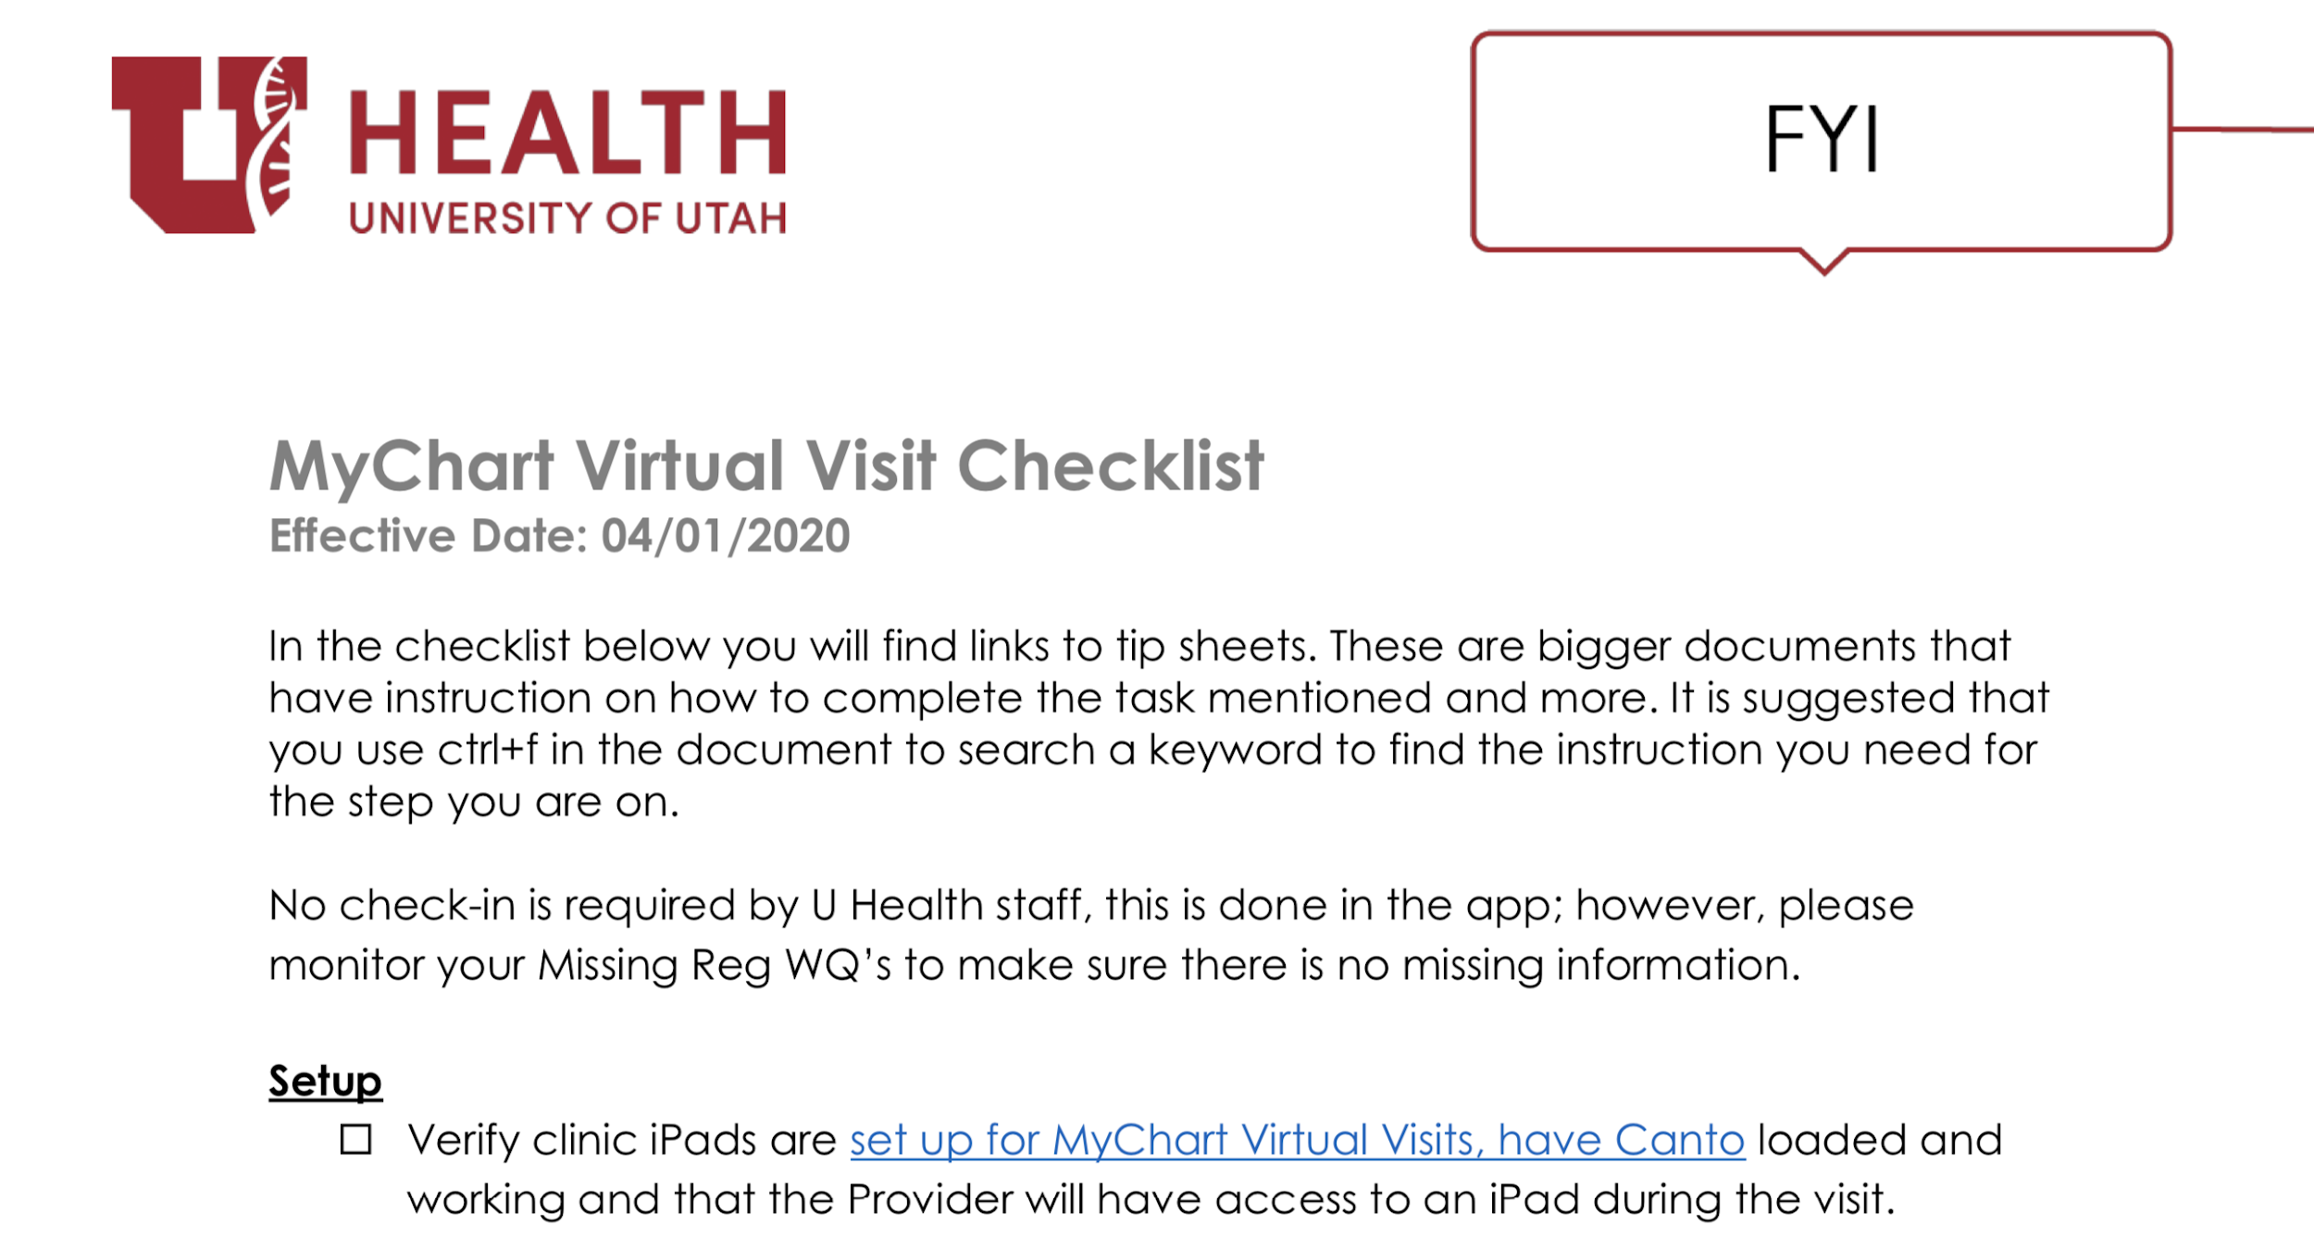
EPIC MYCHART
MyChart Virtual Visit Checklist
MyChart Virtual Visit Helpful Resources
Notes:
MyChart Virtual Visit Checklist
MyChart Virtual Visit Helpful Resources

Slide 31
ZOOM
What is Zoom? - TeleHealth Training Module
Click here to start a visit
Your provider will have a list of appointments. Highlight the appropriate visit.
Notes:
Zoom Tip Sheet
Using Zoom for TeleHealth Treatment - Training Module
Providers - Zoom for Virtual Visits - Tip Sheet
Using Zoom: Security Best Practices - Article
How to Keep Zoom Meetings Secure
Conducting a TeleHealth Visit via Zoom During COVID-19

Slide 32
ZOOM APPEARANCE
Your Name
Using this function, you can choose a professional background
Using this function, you can share your screen and go over imaging with them
University of Utah backgrounds to use with Zoom: https://umc.utah.edu/resources/asset-downloads/zoom-backgrounds/

Slide 33
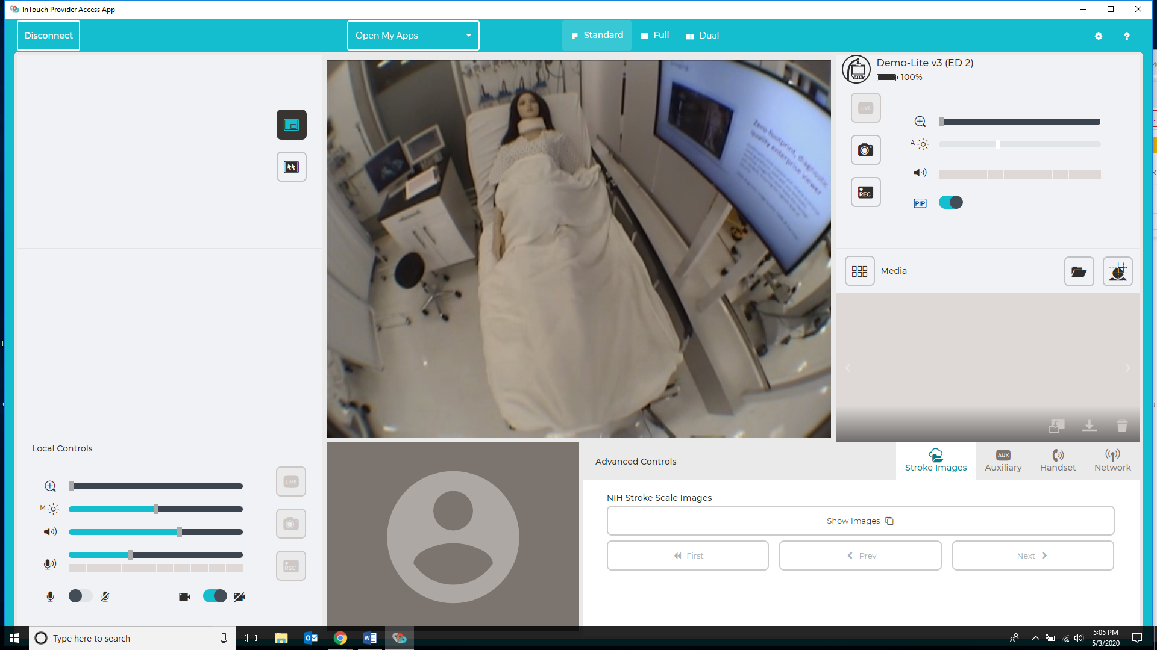
INTOUCH
InTouch Training Module
Notes:
InTouch Provider Training Module
InTouch Provider Training - Video
Provider Specific Use of InTouch During COVID-19
Using the InTouch Consumer iOS App

Slide 34
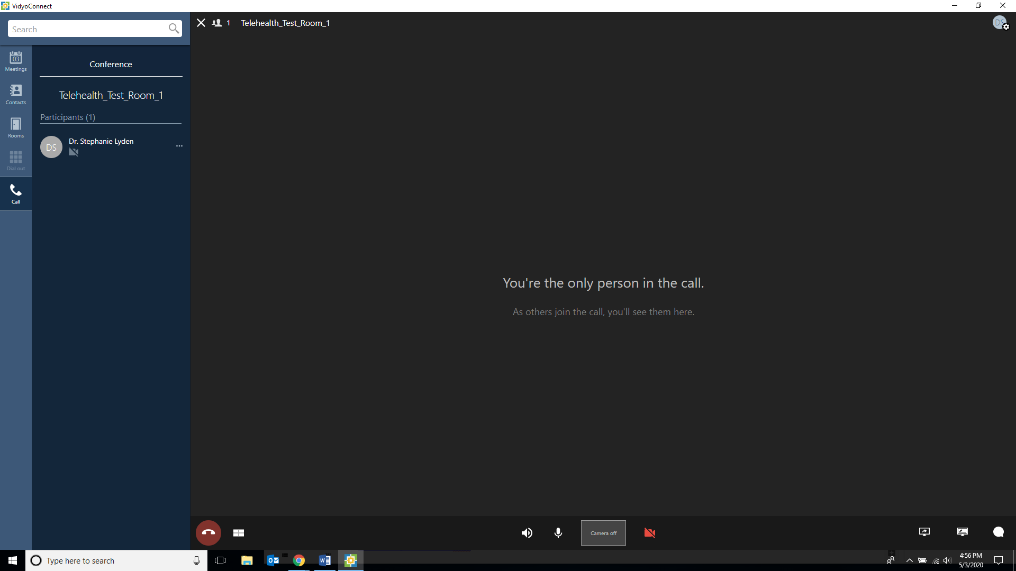
VIDYO
VIDYO Set Up Instructions
Notes:
Vidyo Provider Training
Screen Sharing with a Patient - Vidyo

Slide 35
Essentials of telehealth

