Slide 1
The Place of Informatics in Modern Medicine
Andrew Balas MD, PhD
Georgia Regents University
Augusta, GA

Slide 2
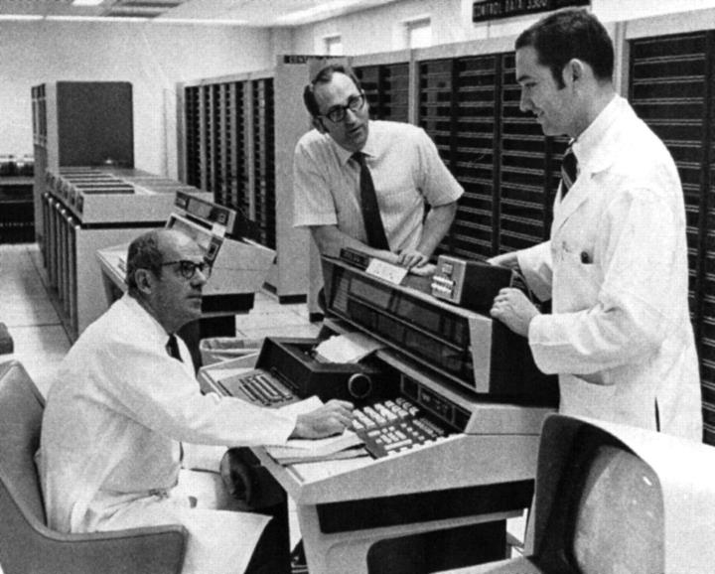
50 years of excellence

Slide 3
The following candidates also took the EHR test but failed:
DEC
Hewlett-Packard
IBM
Microsoft
Google
Siemens

Slide 4
Grand challenges of health care informatics in the 21st century
Making EHR patient centered
Discovery and innovation
Picking up the trash and reducing waste
Developing the perfectionist network
Setting the values right

Slide 5
Making EHR patient centered

Slide 6
Successes and setbacks of health informatics
In 2013, 78% of office-based physicians used any type of electronic health record (EHR) system, up from 18% in 2001.
42 percent of hospitals meet federal standards for collecting electronic health data
only 5 percent also meet federal standards for exchanging that data with other providers
63.9% of physicians reported that note writing took longer
the meantime loss for attending physicians was −48 minutes per clinic day (JAMA, 2014)

Slide 7
Impact of health IT

Slide 8
Meaningful Use
Use information to transform
Improved population health
Improve access to information
Enhanced access and continuity
Data utilized to improve delivery and outcomes
Data utilized to improve delivery and outcomes
Utilize technology to gather information
Patient self management
Patient engaged, community resources
Care coordination
Care coordination
Patient centered care coordination
Patient informed
Evidenced based medicine
Team based care, case management
Basic EHR functionality, structured data
Structured data utilized
Registries for disease management
Registries to manage patient populations
Privacy & security protections
Privacy & security protections
Privacy & security protections
Privacy & security protections
Stage 1 MU
Stage 2 MU
PCMHs
3-Part Aim
ACOs
Stage 3 MU
Notes:
As the ability to integrate and manage grows, so does the data reporting requirements and expanded use of the data.
Take a look at the 4 boxes here on top. It would be hard to rank order them, but the prior steps will allow us to go places we can only now imagine based on studies done on a smaller scale. Achieving MU will help the nation and the world.
Will support advance payment models which are essential to providers and beneficial to patients and consumers.

Slide 9
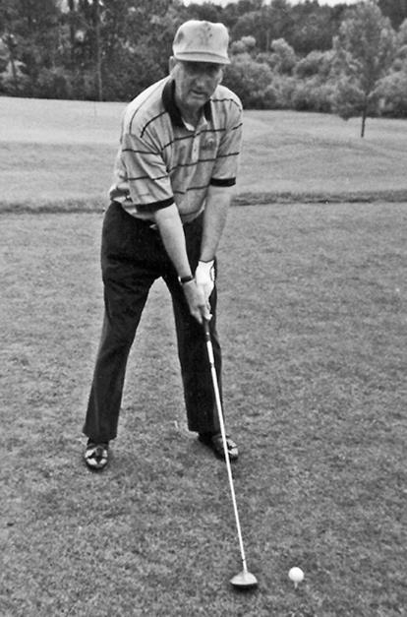
Pryor's Rules
“Capture it all,
we'll sort it out later,”

Slide 10
Examples of alternative analytics
Source | Type of Data | Alternative Use
28% of hospitals nationwide | Patient wealth screening | Grateful Patient Program
Target | Consumer data | Use of shopping pattern identifies marketing strategies, including based on health behaviors: pregnancy, diabetes,
Garmin Connect | Athletic performance data | 4 billion miles of performance information
CRM Healthgrades | Aggregate health data | Sells patient lists based on diagnosis, evaluates hospital patient data for non-compliance and QC
Carolinas HealthCare | Consumer data on 2 million people | Identify high-risk patients. Data aggregated through public records, store loyalty program transactions, and credit card purchases.
LexisNexis | Medicaid recipients and consumer data publicly available (vehicle registration, property records, etc.) | Identify Medicaid Fraud and Abuse

Slide 11
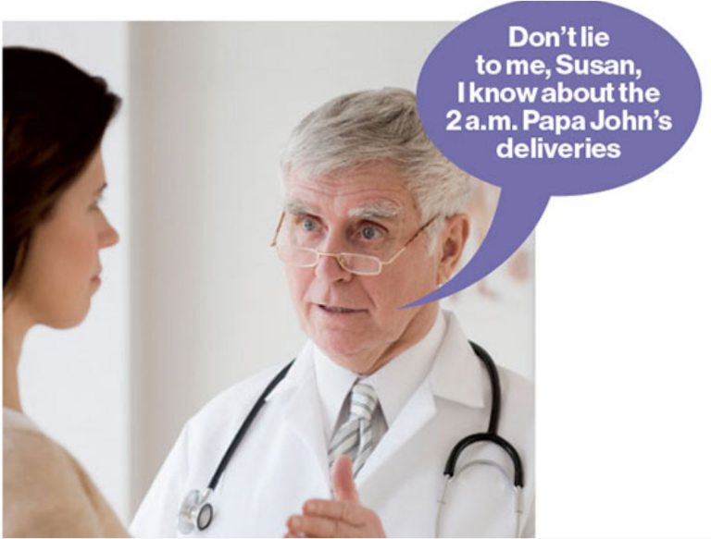
Limitless possibilities

Slide 12
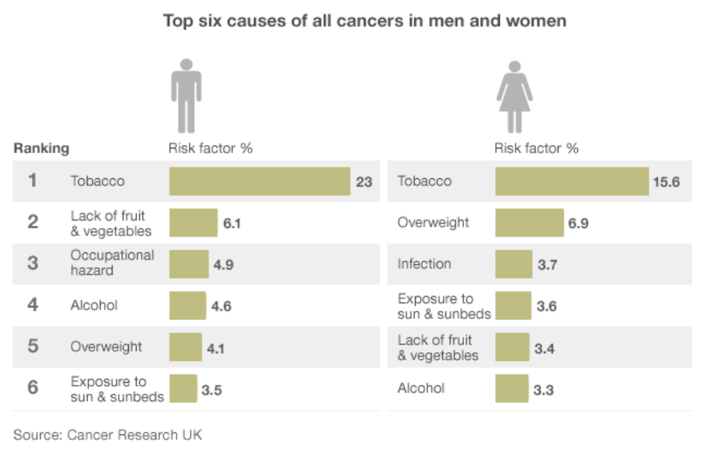
Top six causes of all cancers in men and women
About 40% of cancers diagnosed are caused by avoidable life choices including smoking, drinking and eating the wrong things (BBC)
The Fraction of Cancer Attributable to Lifestyle and Environmental Factors in the UK in 2010
British Journal of Cancer, December 2011

Slide 13
Right to receive personal health information
The Mayo medical record
Emergence of e-patient
Self-care with hemangiopericytoma
Blue button initiative: a way to get your health records electronically

Slide 14
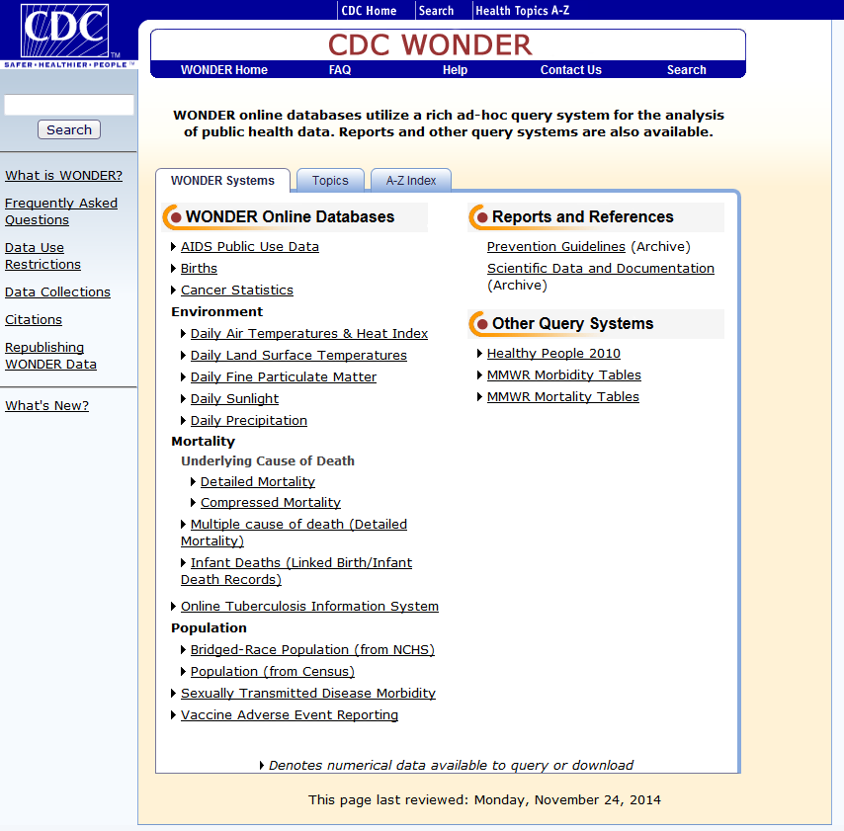
CDC
http://wonder.cdc.gov/

Slide 15
RWJF
http://www.countyhealthrankings.org/

Slide 16
Discovery and innovation

Slide 17
Propellant Recognition of Public Health Needs
Many research innovators show exceptional recognition of societal needs, purposeful search for the new technology solution and also the passion to find answer to a specific need
Harald zur Hausen discovered the role of papilloma virus in cancer of the cervix
HPV vaccine and 2008 Nobel Prize Nobel Prize in Physiology or Medicine
He was a virologist, laboratory researcher, expert in cell and DNA studies
zur Hausen’s research hypothesis was grounded in epidemiologic analyses of societal needs and distribution

Slide 18
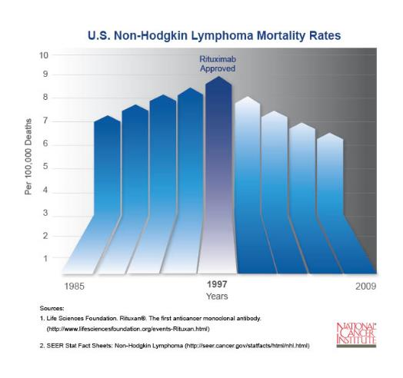
Propellant Learning from nature
Many successful innovators developed important technologies by observing a natural solution to an identical or similar problem (e.g., Jenner’s smallpox vaccine).
In the 60s toxic treatments of lymphoma
Antibodies might provide the clues needed to diagnose and treat cancer
In 1975, César Milstein and Georges Köhler produced monoclonal antibodies that target one specific protein. Nobel Prize in 1984
Biogen Idec, a biotechnology company, developed Rituximab, an antibody that recognizes CD20 , a target shared by B-Cell lymphoma cells. The antibody activates the immune system that attacks the cancer cells.

Slide 19
The best of both worlds: biomedical research innovation
Science |  | Invention
Replicable |  | Useful
Generalizable |  | Novel
Peer-reviewed |  | Non-obvious

Slide 20
Schinazi’s Laboratory of Biochemical Pharmacology
Dr. Schinazi’s lab was established in 1983 at the Atlanta VAMC and
Staff of 23 PhD researchers, 3 graduate students, 3 support personnel
Ongoing projects are primarily funded by multiple grants from the NIH, including one from Emory’s Center for AIDS Research (CFAR)
Founder of 4 biotech/pharmaceutical companies
Secured more than 90 US and international patents
Over 480 peer reviewed papers and 7 books
Important discoveries:
HIV/AIDS drugs taken by 90% of individuals receiving treatment
10 NDAs at the FDA
Current research focus:
Developing a number of approaches to the treatment of infections caused by HIV, herpes viruses, HBV, HCV, and Dengue virus
antiviral agents as well as synthetic, biochemical, pharmacological, and molecular genetic approaches, including molecular modeling and gene therapy
preclinically develop in-house compounds for the prevention and treatment of these important pathogens
Development of treatments for the protozoa Cryptosporidium parvum

Slide 21
Performance scenarios of a standardized university of 1000 faculty
Phase of Innovation | Average institution | Top 25% institution | Top 10% Institution
Disclosure
Peer-reviewed publications | 336 | 499 | 737
Intramural Disclosures | 14·7 | 23·7 | 36·8
Publications/IP Disclosure Ratio | 24·8 | 15 | 9·7
Realization
Publications/Patent Applications | 43 | 27 | 13
Publications/Patent awards | 109 | 61 | 37
Publications/Active License Ratio | 18·5 | 9·5 | 4
Outcome
Licensing Revenues | $0·94M | $3·9M | $11·7M
Research expenditure / Start-up Ratio | $63M | $36M | $23M

Slide 22
Median survival for the Cystic Fibrosis registry population in the United States
Progress without breakthrough:
Better knowledge management
Adapted From 2010 Annual CFF Data Report to the Center Directors

Slide 23
Picking up the trash and reducing waste

Slide 24
Original research (100%)
Negative results: 18%
Dickersin, 1987
variable
Submission
Negative results: 46%
Koren, 1989
0.5 year
Kumar, 1992
Acceptance
0.6 year
Kumar, 1992
Publication
Lack of numbers: 35%
Balas, 1995
0.3 year
Poyer, 1982
Bibliographic
databases
Inconsistent indexing: 50%
Poynard, 1985
6. 0 - 13.0 years
Antman, 1992
Reviews,
guidelines,
textbook
5.8 years
Balas, 2000
Implementation
(14%)
On average, it takes 17 years to turn 14 per cent of original research to the benefit of patient care
Balas EA, Boren SA. Managing Clinical Knowledge for Health Care Improvement. Yearbook of Medical Informatics. Schattauer, 2000:65-70.

Slide 25
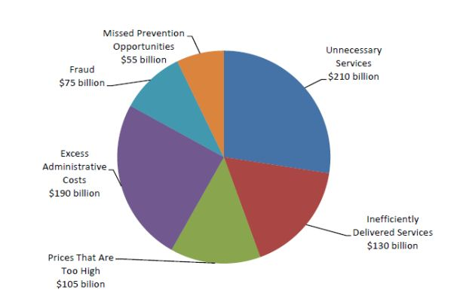
Waste and inefficiency
Best Care at Lower Cost: The Path to Continuously Learning Health Care in America. Institute of Medicine, 2012

Slide 26
Eroom’s Law in pharmaceutical R&D
Nature review, 2012

Slide 27
Frequency of deficiencies in EHR-based research and surveillance
Source | Estimate | Reference
Incompleteness | 24% | Walker J, et al. BMJ. 2015 Botsis T, et al. AMIA summit 2010 Denham CR, et al. Journal of patient safety. 2013
 | 86% | Thiru K, et al. BMJ. 2003
 | 65% | Kopcke F, et al. BMC 2013
 | 86% | McGinnis KA, et al. Medical care. 2009
CPOE Errors | 51.4-91.5 | Koppel R, et al. JAMA 2005
Inaccuracies, errors | 4.3 % | Weiss J, et al. American Acad of Ophth. Annual Meeting; 2014
Inconsistencies | variable | Walker J, et al. BMJ. 2015 Botsis T, et al. AMIA summit 2010

Slide 28
If you torture the data long enough,
it will confess anything you want.

Slide 29
Non-repeatable research
Five of 7 largest molecular epidemiology cancer studies did not classify patients better than chance (JNCI, 96:2004)
Microarray drug sensitivity signatures – from cell lines – to predict patient response (named one of top100 breakthroughs in 2006) could not be reproduced in large clinical trial in 2009 (Nature Medicine, 2006)
Assessment of 18 published microarray studies: 2 were reproducible (Science, 2011)
Bayer Healthcare reported reproducibility rates of 25% in its attempt to repeat discovery research( Nature Reviews Drug Discovery 10, 712, 2011)
Amgen attempts to verify results of 53 landmark studies in oncology and hematology; only 6 (11%) could be reproduced. (Nature 483, 531-533, 2012)

Slide 30
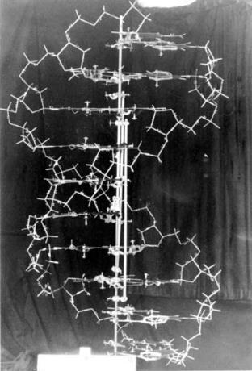
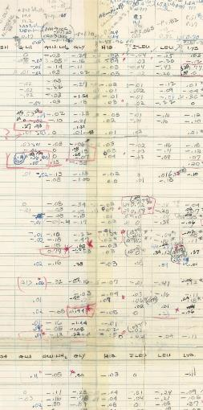
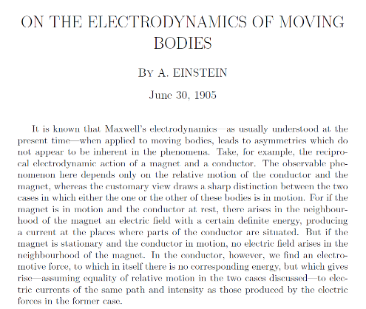
We need more models and fewer hypotheses!

Slide 31
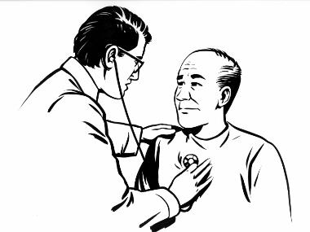
We should rethink the Methods section
Patient: When I do the following:
slowly raising my arm,
then twisting it - palm looking backward,
pushing it downward and backward,
at the lowest point pulling it forward,
quickly twisting in reverse direction, and
finally raising my arm to the original position
then I feel terrible pain.
What is your prescription?
Doctor: Don't do it anymore!
Patient: Then how should
I put on my shirt?

Slide 32
Developing the perfectionist network

Slide 33
Selected EHR data aggregators
Blue Health Intelligence | Claims data on 210 million individuals, available longitudinally
Aetna – Accountable Care Solutions | Claims data on Aetna subscribers
Validic | Commercial firm, data aggregator for physicians and health systems
Kaiser Permanente Health Connect (Northern CA) | 9.1 million patients Subscriber health claims data
OCHIN | Members of 70 health system across 19 states
IMS® Disease Analyzer | EMR are contributed by a representative panel of more than 2.500 physicians in Germany
Humana Health Care – Anvita Health | 11.2 million members health data
Cerner Health Facts | Since 2000, EHRs/EMRs collected from 480 contributing facilities throughout USA
Vestrum | EHR data from private physicians
MS HealthVault | Personal health information of "far more" than the tens of thousands of users

Slide 34
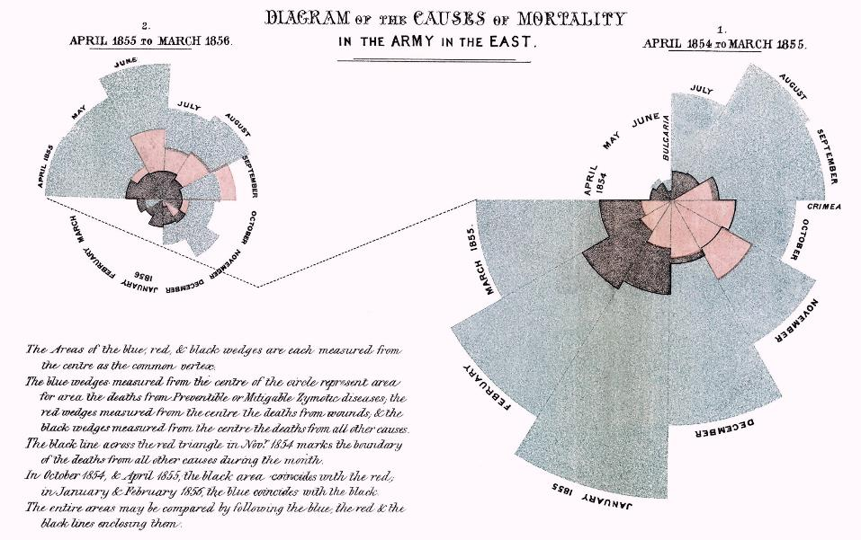
Florence Nightingale -> We need new ways to see Big Data

Slide 35
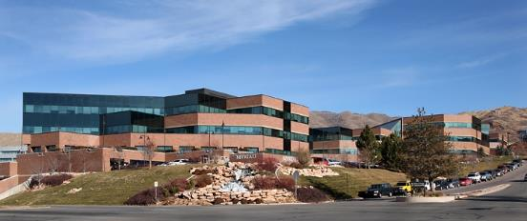
Partner with industry to recognize needs and develop solutions
Albert Einstein, the theoretical scientist who developed his theory of relativity while working in a patent office. Later had 19 awarded patents
1986 – Dr. Leroy Hood worked in collaboration with Applied Biosystems to invent the DNA sequencer and synthesizer. Other inventions include the automated protein sequencer and synthesizer. Co-founded more than 14 companies, including Amgen and Applied Biosystems
Langer Lab at MIT Over 1200 publications, 815 issued and pending patents worldwide, patents have been licensed or sublicensed to over 250 pharmaceutical, chemical, biotechnology and medical device companies.
Immersion in the real world and close collaboration with patients and industry are the hallmarks of many innovative research projects.
We have to learn how to work with companies and also customers or patients in developing productive research.

Slide 36
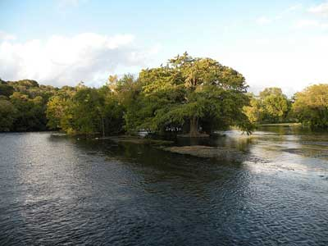
Propellant: Traveling to places of need
Often the best way to learn about a need that others fail to recognize is travelling, meeting the people and seeing the place. “Go where the problems are” (Al Sommer)
Peter Piot, a 27-year-old scientist
In 1976, he received a thermos with melting ice cubes and vials of blood from a nun who had fallen ill with a mysterious illness in Zaire
He identified a Marburg like but different virus
Two weeks later Piot travelled to Kinshasa and 1,000km (620 miles) further north; the priority was to stop the epidemic.
They named the virus after the closest river, Ebola River.

Slide 37
Your network of information should include
Big data studies
Learning from history
Traveling to places of need
Meeting patients
Fellow professionals
Dedicated clinicians
Great companies

Slide 38
Setting the values right

Slide 39
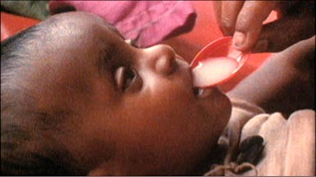
Propellant Values of humanism drive innovation
Many scientists are deeply motivated by a sense of humanism and compassion, helping others in need (-> white coat ceremonies)
Dr. Norbert Hirschhorn inventor and developer of Oral Rehydration Therapy;
1968 - Worked in East Pakistan with the US Public Health Service during a cholera outbreak (40% of villagers dying)
He designed a solution of sugar, salts and water; had to fight his supervisor, who had previously tried but failed
Public health impact: Estimated ORT has saved over 50 million people
“Seeing someone recover from such life-threatening illness is "like seeing Lazarus come back from the dead - a miracle."

Slide 40
What is public health?
“Public health is what we, as a society, do collectively to assure the conditions for people to be healthy.”
Future of Public Health
Institute of Medicine (IOM) , 1988

Slide 41
Ten Great Public Health Achievements -- United States, 1900-1999
Vaccination
Motor-vehicle safety
Safer workplaces
Control of infectious diseases
Decline in deaths from coronary HD and stroke
Safer and healthier foods
Healthier mothers and babies
Family planning
Fluoridation of drinking water
Recognition of tobacco use as a health hazard
MMWR Morb Mortal Wkly Rep. 1999 Apr 2;48(12):241-3.

Slide 42
Seven steps of Research Root Discovery
RRD-7
7. | Public health achievement | Prevention of dental caries nationwide: for every $1 spent on fluoride, saves $38 in dental treatment; one of Ten Great Public Health Achievements -- United States, 1900-1999 CDC
6. | Public health validation study | Reduces incidence by 60% in 200,000 school children (1956)
5. | Development of societal action, practice, product or service | Fluoride concentration: at 1 ppm, did not cause staining and was protective of enamel. Grand Rapids, MI volunteers to be the first city to add fluoride to their water (1945)
4. | Landmark scientific discovery | Something in the water was causing this (1923) Advanced analysis technique identified high levels of fluoride in the water samples (1931)
3. | Research leading to the discovery | Only children developed the stains, they were permanent, and they were “inexplicably resistant to disease.”
2. | Researcher(s) playing key role in the discovery | Dr. Frederick McKay and Dr. GV Black, Dr. Grover Kempf and Dr. HV Churchill; Dr. Tredley Dean (NIH) Dr. Elias Elvove (NIH)
1. | Triggers and influencers of successful research | Brown teeth mottling phenomenon discovered in Colorado Springs, CO – Colorado Brown Stain (1901)

Slide 43
Fog of war
“All action takes place, so to speak, in a kind of twilight, which like a fog or moonlight, often tends to make things seem grotesque and larger than they really are.”
“Two qualities are indispensable: first, an intellect that, even in the darkest hour, retains some glimmerings of the inner light which leads to truth; and second, the courage to follow this faint light wherever it may lead.”
Carl von Clausewitz

Slide 44
Three Magi of medical informatics
Driven by values
Persistent in effort
Promoted debates
Taught respect
Offered many gifts
to others

Slide 45
Our challenges in the 21st century
Make EHR patient centered
Discover and innovate
Pick up the trash and reduce waste
Develop the perfectionist network
Follow the right values

Slide 46
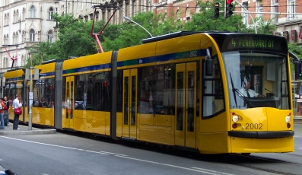
One last question for the road ahead…
Junior passenger:
What do you know about us? You were born and raised when there was no computer, no internet and no mobile phone.
Senior passenger:
Yes, we were born and raised when we did not have any of those technical wonders. So we invented them for your generation.
What will you invent for future generations?

Slide 47
Happy 50th Anniversary!

