Slide 1
The Beginnings of Informatics at the University of Utah The First Few Years
Reed M. Gardner, PhD
Emeritus Professor and Former Chair,
Department of Biomedical Informatics
Biomedical Informatics 50th Anniversary Celebration
18 April 2015

Slide 2
Initial Introduction to Homer R. Warner The Beginnings of a Life’s Trek
WHEN: January 1960
WHO: Dr. Robert Stephenson, Prof Electrical Engineering
WHERE: In an EE Senior Project Course
WHAT: Wanted volunteers do “medical engineering” work with Dr. Homer Warner at LDS Hospital for Senior Projects
WHO WENT: At least 3 of us including myself and classmate W. Sanford (Sam) Topham
RESULT: Initiation of a new Department at the University of Utah – among the first in the World to formally use computers in medical research.
Analog Computers at first then Digital Computers – which were just becoming available

Slide 3
On Retirement - A New Avocation for Reed - A Desire to Preserve History
With Jackie, completed a History of my Great Grandfather - an 1847 Utah Pioneer who helped settle St. George
Decided it was time to collect publications of Warner, Pryor and Gardner for archival purposes
Surprisingly found that Homer & Al had fewer “records” than I did. Set out to get reliable CVs and publication records
Became acquainted with new and powerful “on-line” tools in the Eccles and Marriott Libraries
Sought out and found over 600 publications by Warner, Pryor and Gardner – now have pdf copies of almost all of them in my laptop EndNote library – soon to be openly available on University of Utah’s USpace archive!
Gave Homer a copy of EndNote for his Mac with Warner, Pryor, Gardner files for his 90th birthday!

Slide 4
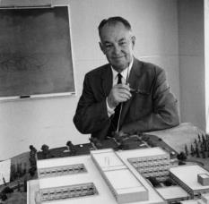
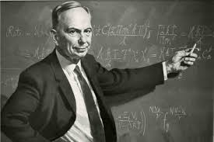
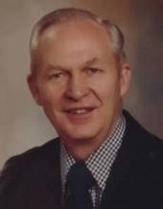
Biophysics & Bioengineering
Department – Establishment
Which College?
Engineering OR Medicine
4 December 1963
Kenneth B. Castleton, MD, PhD
Dean of Medical School
Henry Eyring, PhD
Dean of Graduate School
University of Utah
Homer R. Warner, MD, PhD
“Biophysics & Bioengineering”
Department Chair “in waiting”
Robert E. Stephenson, PhD
Associate Dean
School of Engineering
Based on Memo by Jack H. Adamson, PhD
Academic VP at University of Utah

Slide 5
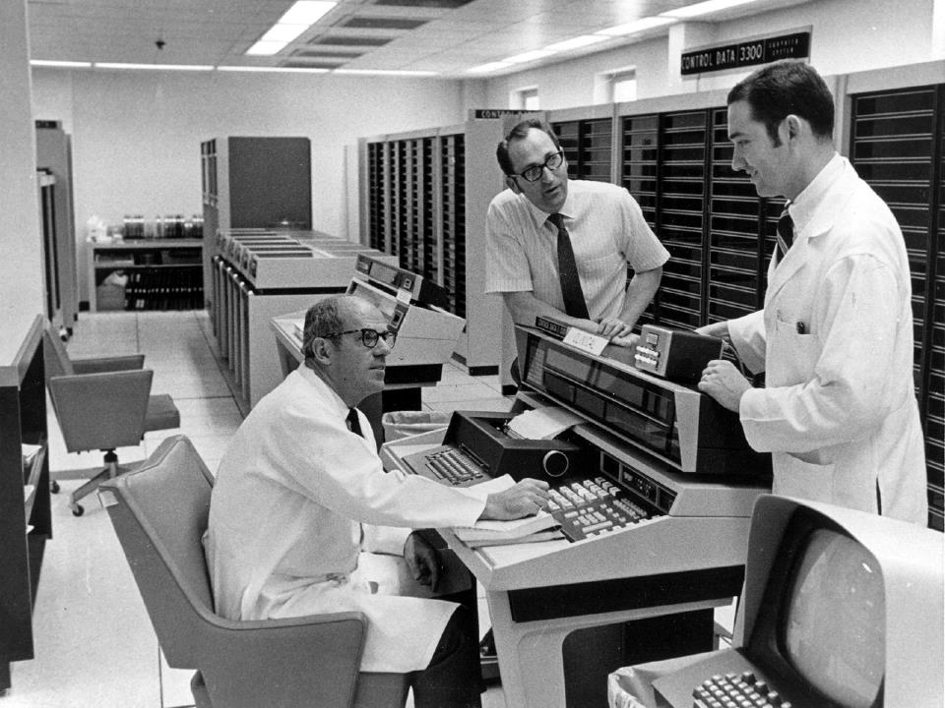
HELP System Computer Room
LDS Hospital – Salt Lake City, UT
1968 – “wall to wall computers”
T. Allan Pryor, PhD
B 5 Dec 1937 D 15 Mar 2009 Age 71 Publications 114
Reed M. Gardner, PhD
B 24 Oct 1937 Age 77
Publications 363
Homer R. Warner, MD, PhD
B 18 Apr 1922 D 30 Nov 2012 Age 90
Publications 186
Joint Publications over 600

Slide 6
Genetic Epidemiology (Gen Epi)
Creation & Accomplishments
Departmental Pioneers
Mark H. Skolnick, PhD – Faculty 1975
Lisa Cannon-Albright, PhD – Grad 1988
Neither was available today, so Lisa
kindly shared some historical slides

Slide 7
Genetic Epidemiology (Gen Epi) Timeline
1970’s
Mark Skolnick, PhD at Stanford (1975), constructed a computerized genealogy in the Parma Valley (Italy) from parish records. He was later invited by Dr. Charles Smart, Chief or Surgery at LDS Hospital who had established a “Tumor Registry” - to discuss use of the Mormon genealogical library for cancer research
Mark was appointed as an Assistant Professor in 1975 to Dr. Homer R. Warner’s then “Department of Biophysics & Bioengineering” – He built the computerized Utah Genealogy, linked it to cancer data and began to study high-risk breast cancer pedigrees
The computerized Utah Genealogy was donated much later (after ~ $25 M in grant funding) to the University of Utah Cancer Center and has become the Utah Population Data Base (UPDB)

Slide 8
Gen Epi Timeline
1990’s
Mark Skolnick co-founded Myriad Genetics
Gen Epi collaborated with Myriad with to study high-risk cancer pedigrees and analysis methods to localize genes
Gen Epi and Myriad jointly discovered BRCA1, BRCA2, and CDKN2A as the first (and still the only) major cancer predisposition genes
This research remains one of the University’s most famous
and successful commercialization efforts and has saved
countless lives

Slide 9
University of Utah Catalogues as HISTORICAL Documents
First visually searched Catalogues in the “Special Collections” area at the Marriott Library
Then got electronic access to scanned documents from home
Acquired Faculty and Curriculum for the past 50 years from the Catalogues (pdf)
Found we have had more than 115 Faculty members over the past 50 years
Still a work in progress

Slide 10
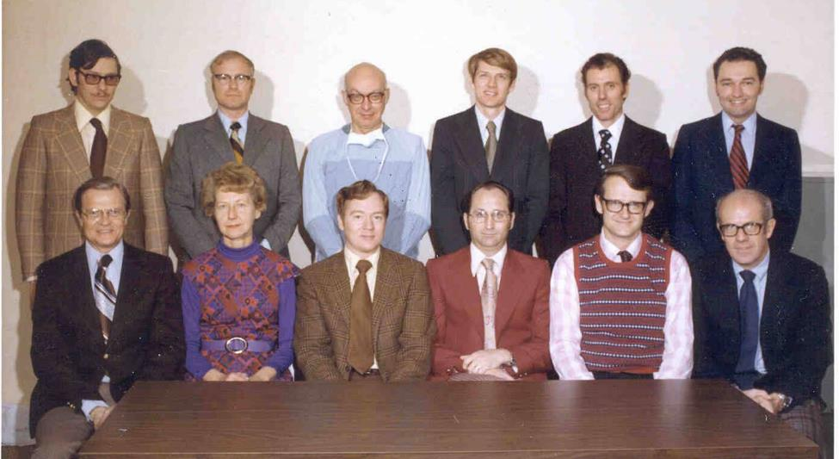
1975 Faculty Photo Department of Medical Biophysics and Computing

Slide 11
Dissertations & Theses as HISTORICAL Documents
First went to Eccles Library to “look” at the paper documents – they were ALL GONE!!
Then “found” paper documents in the BMI Department offices - got scans of title pages and Abstracts (pdf) of those
Found there were many Dissertations and Theses in the Upro files at Marriott Library – at the moment not complete
Found remainder of documents at ProQuest database in Ann Arbor, Michigan
Graduates, Dates, Titles of documents recovered – but still a work in progress

Slide 14
 | FIRST 15 “MEDICAL INFORMATICS” GRADUATES AT UTAH
# | AUTHOR | DEPARTMENT | GRADUATION DATE | DEGREE | DISSERTATION OR THESIS TITLE
1 | Topham, W. Sanford (Sam) | BB | Aug-65 | PhD | CONTROL OF CARDIAC OUTPUT STUDIED WITH COMPUTER TECHNIQUES
2 | Peterson, William D. | ME | Jun-67 | MS | THE TENSILE PROPERTIES OF THE CHORDAE TENDINEAE OF THE MITRAL VALVE IN THE NORMAL HUMAN HEART
3 | Bailey, Leslie E. | Pharm | Jun-67 | PhD | THE EFFECT OF OUABAIN ON Ca45 KINETICS IN THE MYOCARDIUM DETERMINED BY THE TECHNIQUE OF DIFFUSIBLE INDICATOR-DILUTION
4 | Coulam, Craig M. [MD] | BB | Jun-67 | PhD | A STEADY-STATE TRANSFER FUNCTION ANALYSIS OF PORTIONS OF THE CIRCULATORY SYSTEM USING INDICATOR DILUTION TECHNIQUES
5 | Christensen, Burgess N. | BB | Aug-67 | PhD | A QUANTITATIVE STUDY OF THE CAROTID SINUS BARORECEPTORS IN NORMOTENSIVE AND HYPERTENSIVE DOGS
6 | Clark, Justin S. | BB | Aug-67 | PhD | THE EFFECTS OF RAPID TEMPERATURE CHANGES AND LARGE FIELDS ON ELECTRICAL PARAMETERS OF FROG SKIN
7 | Gardner, Reed M. | BB | Jun-68 | PhD | DYNAMIC AORTIC DIAMETER MEASUREMENTS IN VIVO USING ROENTGEN VIDEOMETRY
8 | Robb, Richard A. | CS | Aug-68 | MS | COMPUTER AIDED CONTOUR DETERMINATION OF THE LEFT VENTRICLE FROM SERIAL RADIOGRAPHIC IMAGES
9 | Ostlund, James J. | BB | Jun-69 | PhD | AUTOMATED SCREENING OF ELECTROENCEPHALOGRAPHIC DATA
10 | Johnson, David K. | BB | Aug-69 | PhD | A COMPUTER-BASED AUDIO-RESPONSE SYSTEM FOR CLINICAL MEDICINE
11 | Smith, Edward A. | CS | Aug-70 | MS | A SIMULATION OF A MULTIPHASIC PATIENT SCREENING FACILITY
12 | Morgan, John D. | BB | Jun-71 | PhD | A COMPUTERIZED "CONVERSATIONAL" TECHNIQUE TO FORM NUMERICALLY CODED MEDICAL DIAGNOSES
13 | Thorne, Gale Harrison | BB | Jun-71 | PhD | DEVELOPMENT OF TECHNIQUES BASIC TO THE DESIGN OF A DIGITAL PHYSIOLOGICAL SIGNAL PREPROCESSOR
14 | Wallace, William Dean [MD] | PHYSICS | May-72 | MS | THE DEVELOPMENT OF AN AUTOMATED MICRO-OXIMETER FOR INFANTS (Univ of Wyoming)
15 | Pryor, T. Allan | EE | Jun-72 | PhD | AUTOMATED COMPUTER ANALYSIS OF THE ELECTROCARDIOGRAM

Slide 15
HISTORY - University of Utah Department of Biomedical Informatics NAMES & COLLEGES
 | April 18, 2015
Date | Name |  |  |  | College or School | Time -Yrs. | Sum-Yrs. | % of Time
July 1, 1964 | Biophysics and Bioengineering (BB) - Chair Office at LDS Hospital |  |  |  | Engineering | 8.0 | 8.0 | 15.7%
July 1, 1972 | Medical Biophysics and Computing (MBC) - Chair Office at LDS Hospital |  |  |  | Medical | 13.0 | 21.0 | 25.6%
July 1, 1985 | Medical Informatics (MI) - Chair Office Moved to UofU Medical Center |  |  |  | Medical | 21.0 | 42.0 | 41.3%
July 1, 2006 | Biomedical Informatics (BMI) - Chair Office at UofU Medical Center |  |  |  | Medical | 8.8 | 50.8 | 17.3%
HISTORY - DEPARTMENT CHAIRS
Homer R. Warner |  |  |  |  |  | Years | % of Time
July 1, 1964 |  | Started as BB Chair |  |  | Engineering
Jun 30, 1996 |  | Retired as MI Chair |  |  | Medical | 32.0 | 63.0%
Reed M. Gardner
July 1, 1996 |  | Started as MI Chair |  |  | Medical
June 30, 2005 |  | Retired as MI Chair |  |  | Medical | 9.0 | 17.7%
Joyce A. Mitchell
July 1, 2005 |  |  |  | Start as MI Chair | Medical
Dec 31, 2012 |  |  |  | Retired as BMI Chair | Medical | 7.5 | 14.8%
Julio C. Facelli
January 1, 2013 |  |  | Starts as BMI Interim Chair |  | Medical
August 31, 2013 |  |  | Ends BMI Interim Chair |  | Medical | 0.7 | 1.3%
Wendy W. Chapman
Sept 1, 2013 |  |  | Starts as BMI Chair |  | Medical
April 18, 2015 |  |  | Continues to Serve as BMI Chair |  | Medical | 1.6 | 3.2%
 |  |  |  |  | Total | 50.8

Slide 16
Thanks to Librarians & Archivists at Eccles, Marriott Libraries & NLM
Donald A. B. Lindberg, Former Director NLM
Heidi Greenfield, Eccles
Melissa Rethlefsen, Eccles
Mike Thelin, Eccles
Jeanne LeBer, Eccles
Lois Barlow, BMI
Rebecca Goodwin, NLM
Dean Sittig, U Texas, Oral History Taker

Slide 17
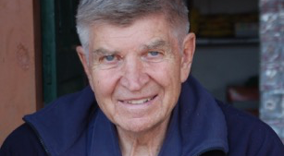
Special Introduction SAM TOPHAM – FIRST Graduate Just Arrived from Kathmandu, Nepal

Slide 18
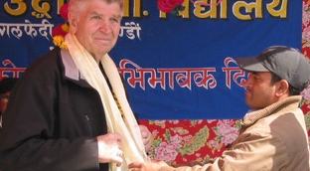
Sam Topham in Nepal 7,575 Miles – 12 time zones away

